Slide 1
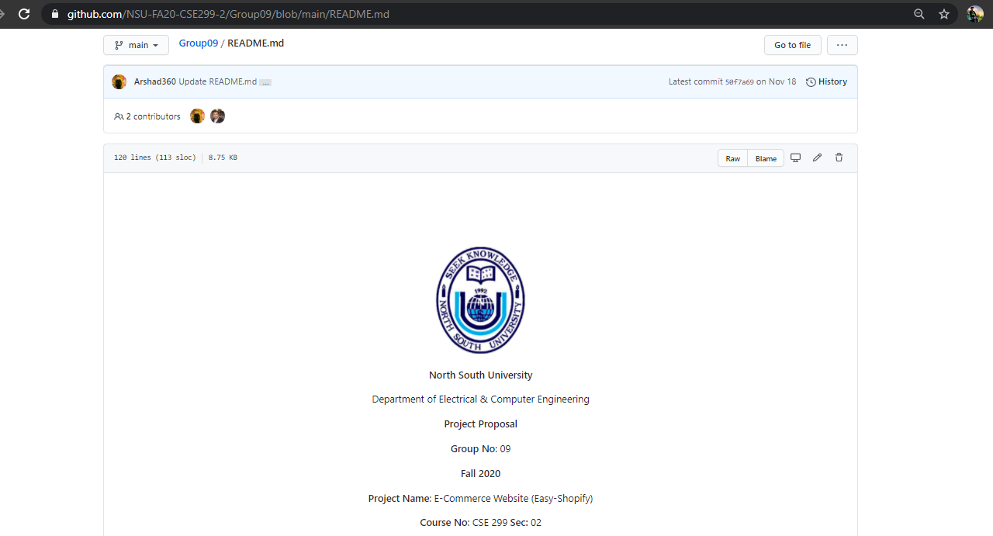
Project Readme

Slide 2
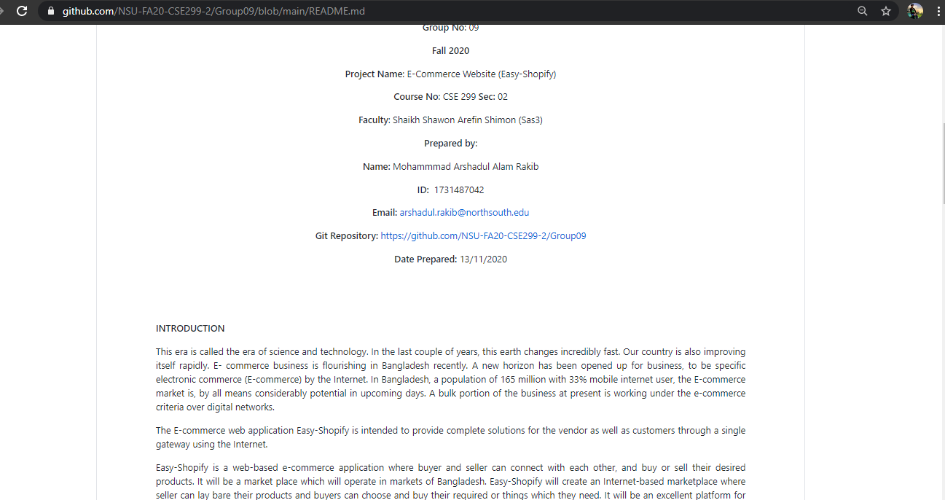
Project Readme (Continue)

Slide 3
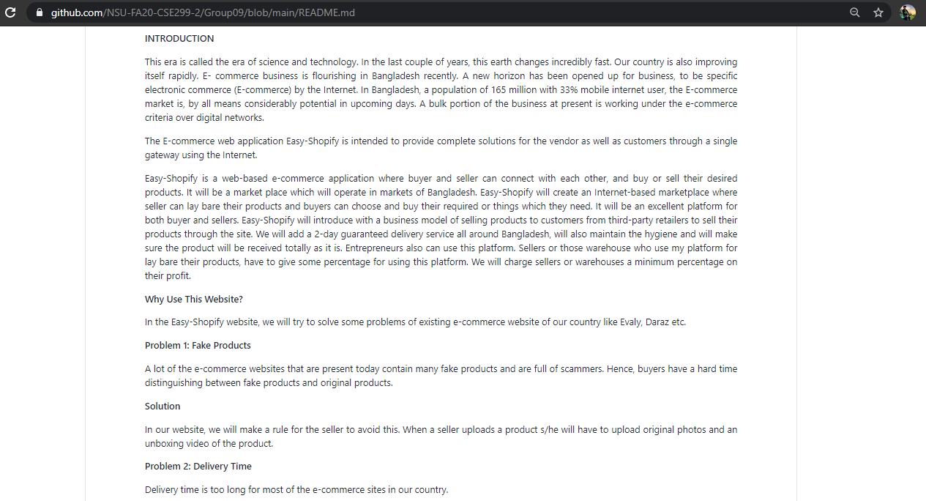
Project Readme (Continue)

Slide 4
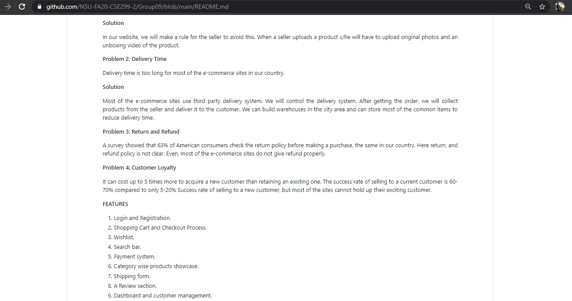
Project Readme (Continue)

Slide 5
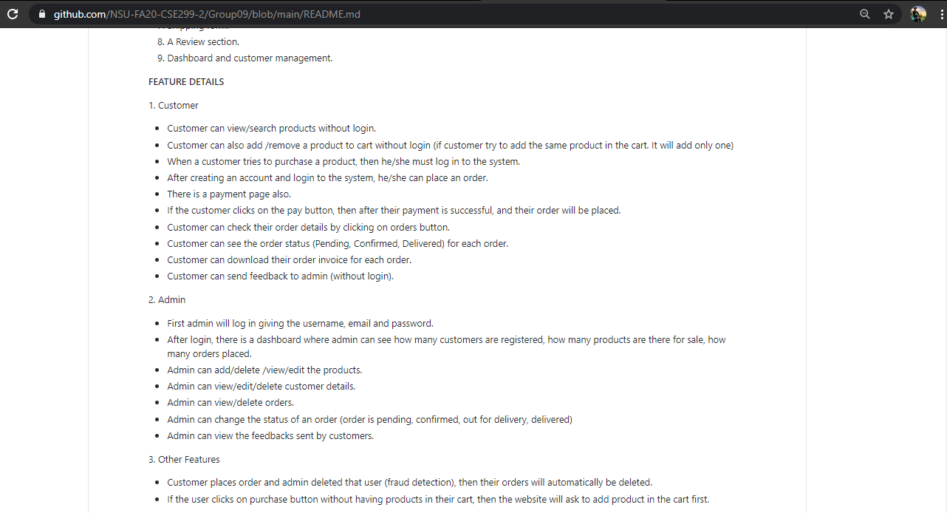
Project Readme (Continue)

Slide 6
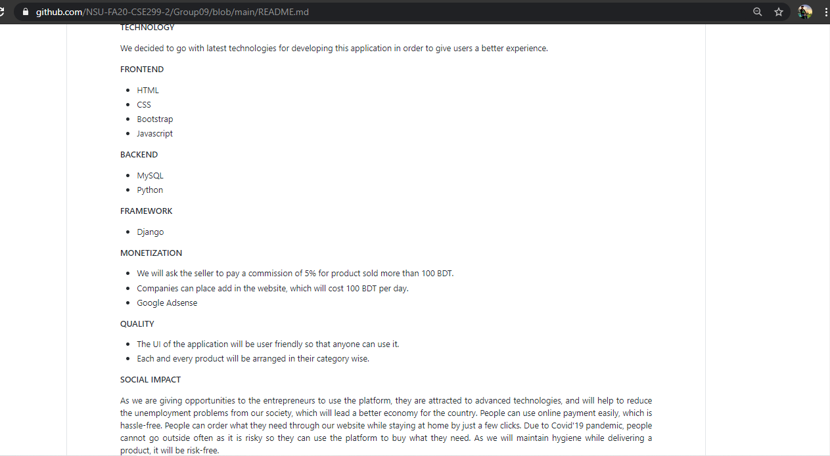
Project Readme (Continue)

Slide 7
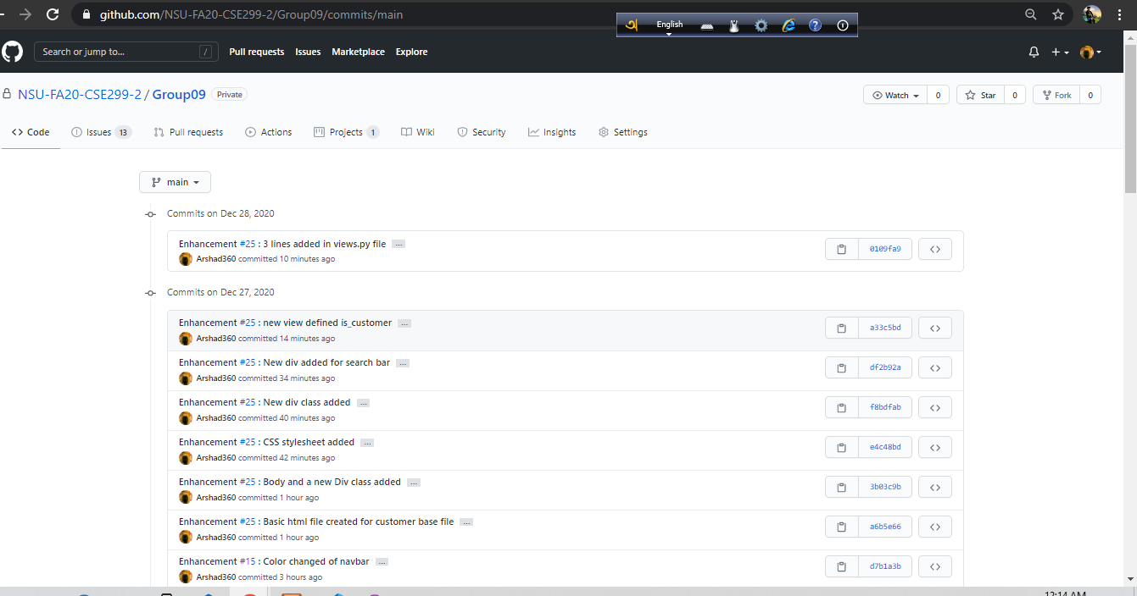
Commits

Slide 8
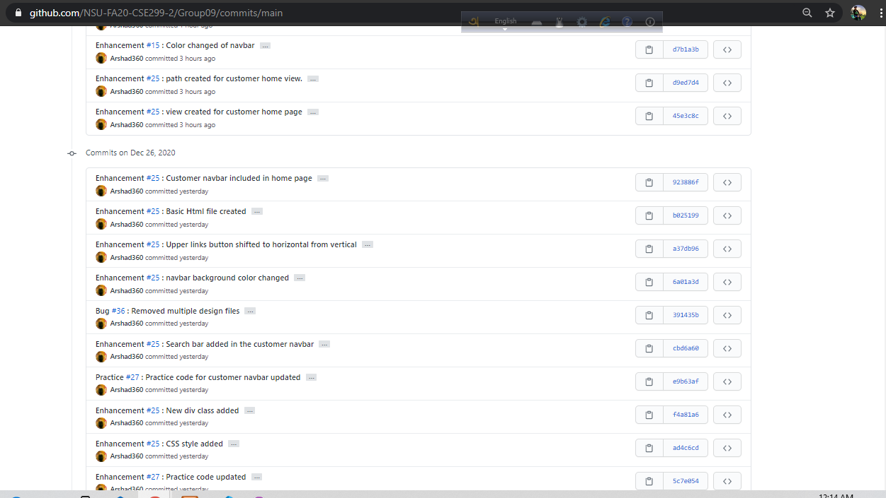
Commits (continue)

Slide 9
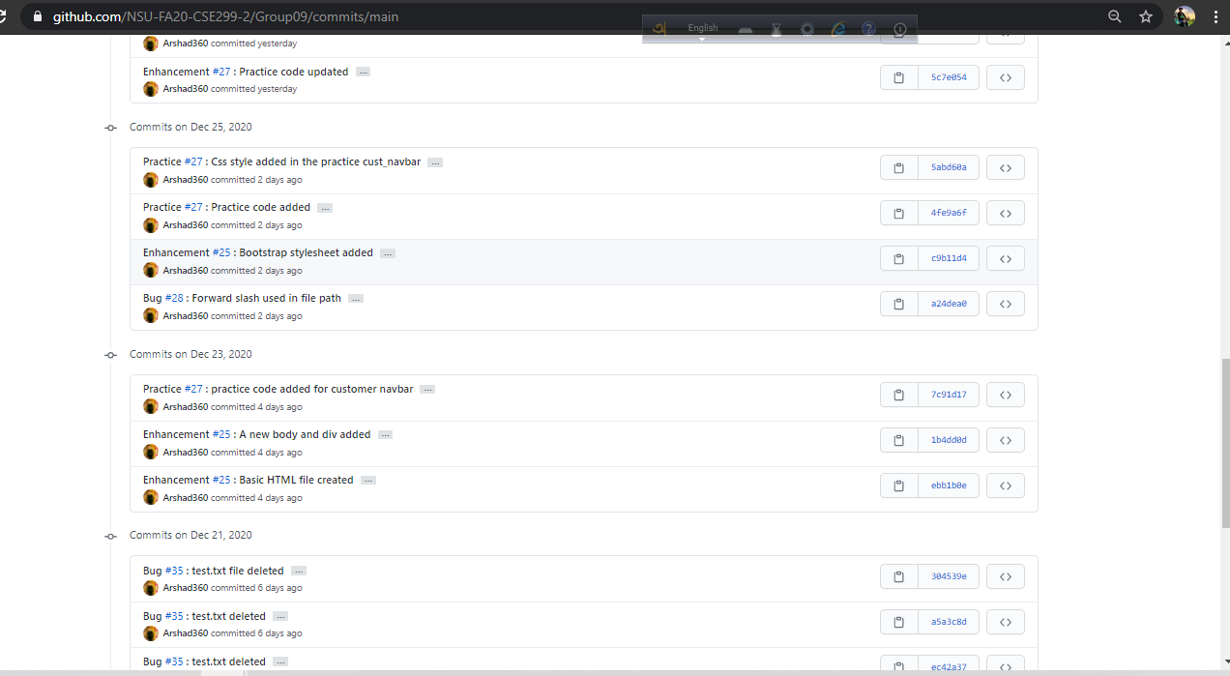
Commits (continue)

Slide 10
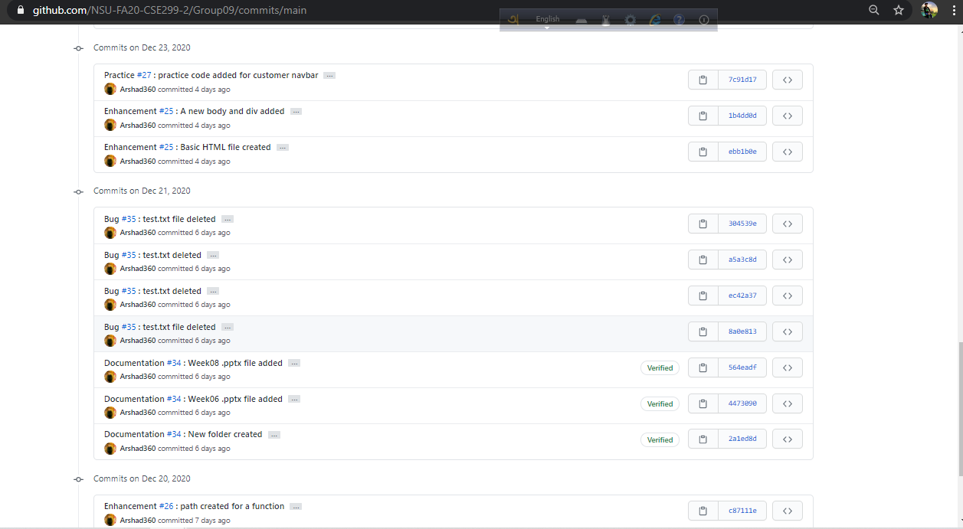
Commits (continue)

Slide 11
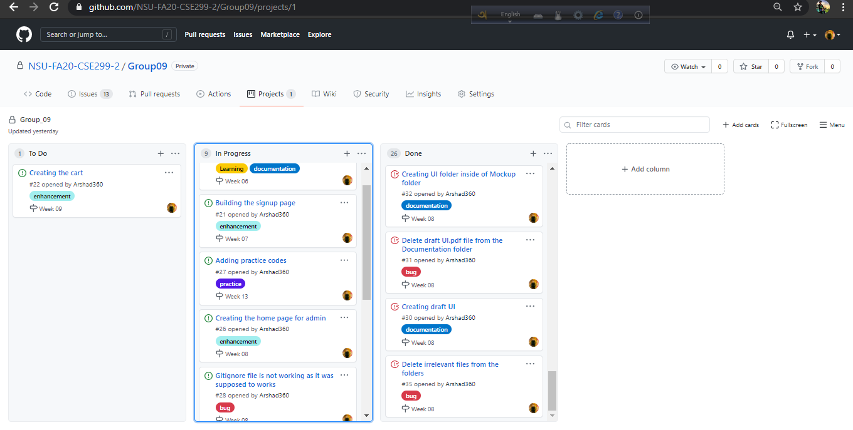
Issue board

Slide 12
The END!

